Slide 1
1.4 Goals, Structure, and Organization

Slide 2
What is Flexibility?
Flexibility—the ability to change—is the key operational goal of business process management. The subjects of change are diverse.
Business process management not only supports changing the organizational environment of the business process, but also facilitates changes in the software layer without changing the overall business process.
business process management also facilitates continuous process improvement. The idea is to evolutionarily improve the organization of work a company performs.

Slide 3
Structure of this book
A business process model is used to represent the structure of this book, as shown in Figure 1.7. The book is organized into three parts, providing a foundation of business process management, looking at concepts and languages for business process modelling, and investigating architectures and methodologies.

Slide 4
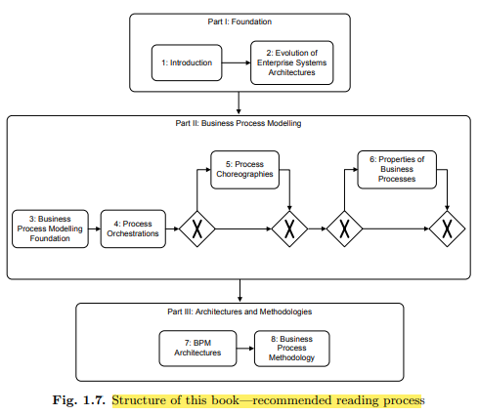

Slide 5
Reference
Chapter 1 has completed.
Please read this chapter, and draw all the diagrams with the help of Visio software and submit in next class in hard form
Also bring your laptops with installed software.
YouTube source Fundamentals of Business Process Management (BPM) Jan Mendling

